Slide 1
Lectures 11-12
CS436/536: Introduction to
Machine Learning
Zhaohan Xi
Binghamton University
^{zxi1@binghamton.edu}

Slide 2
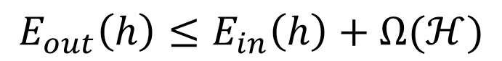
Regularization A cure for overfitting
$$E_{out}\left(h\right)≤E_{in}\left(h\right)+Ω(ℋ)$$

Slide 3
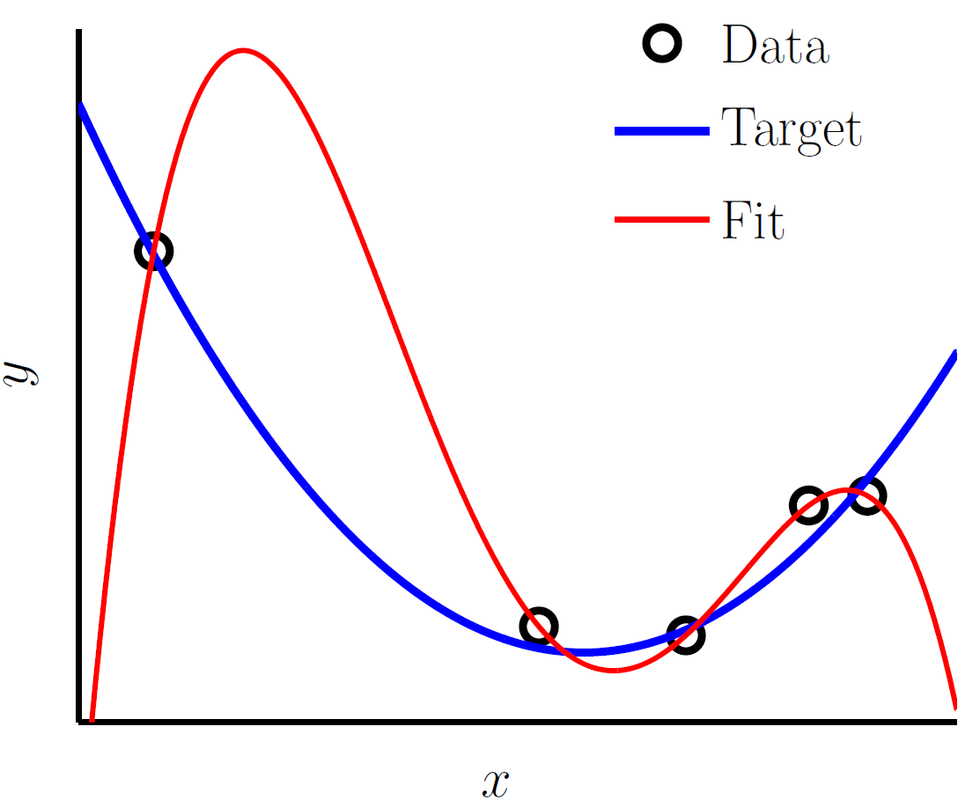
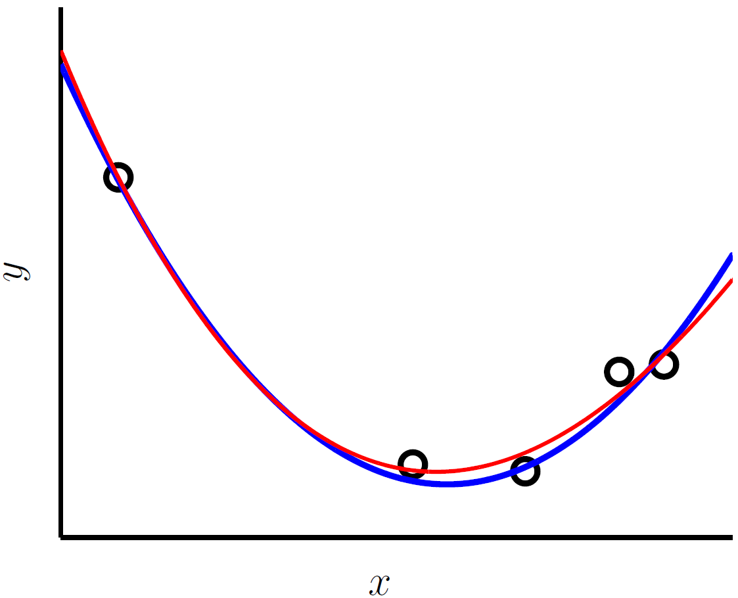
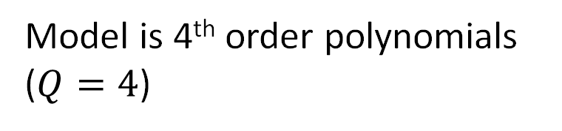
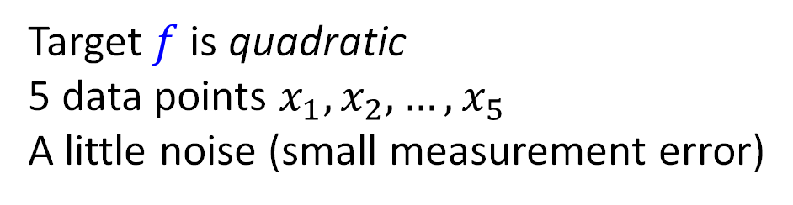
Regularization: Constrain the search
Target $f$ is quadratic
5 data points $x_{1},x_{2},…,x_{5}$
A little noise (small measurement error)
Model is 4th order polynomials
($Q=4$)

Slide 4
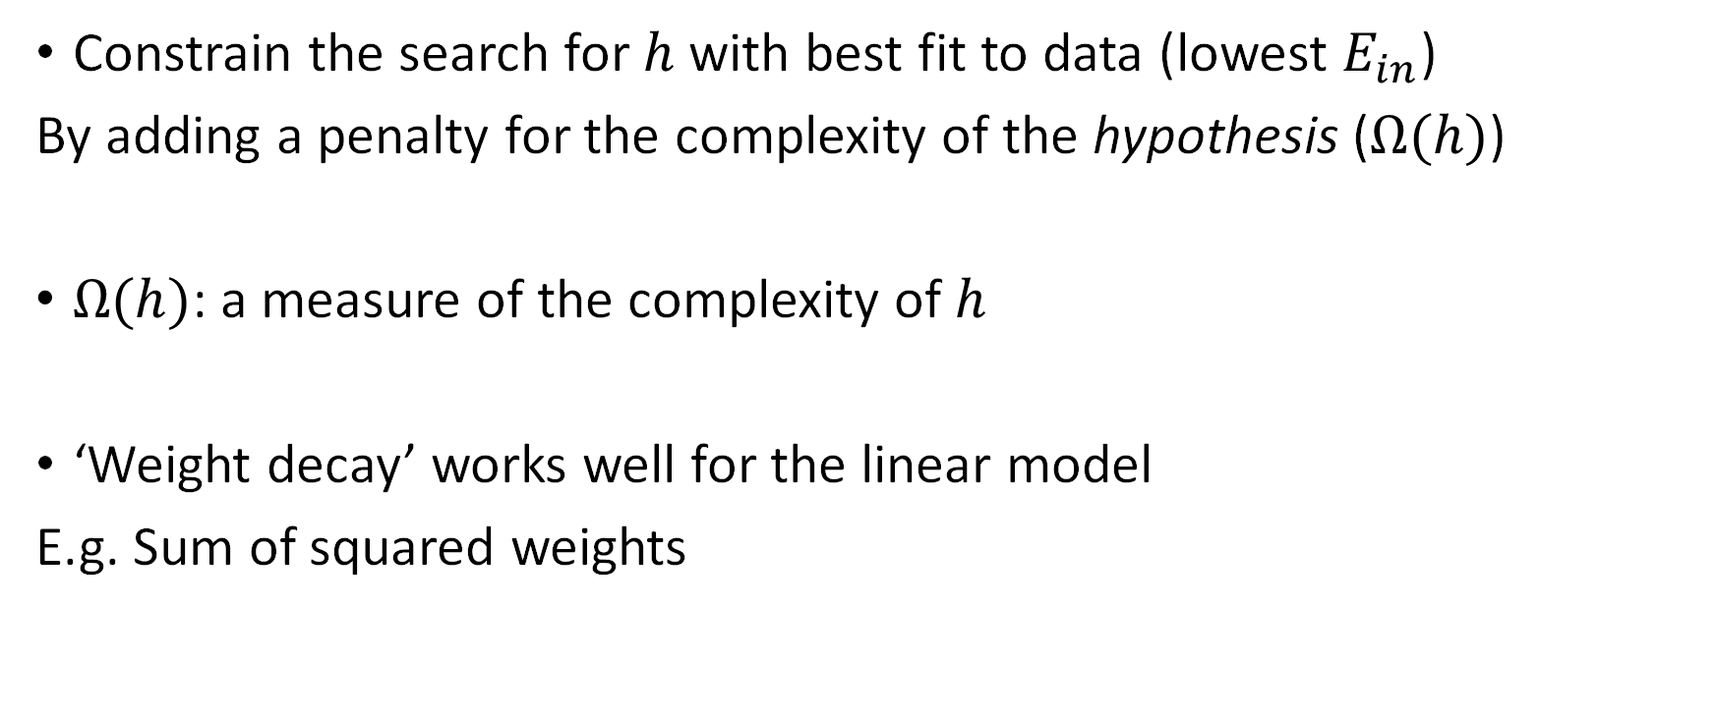
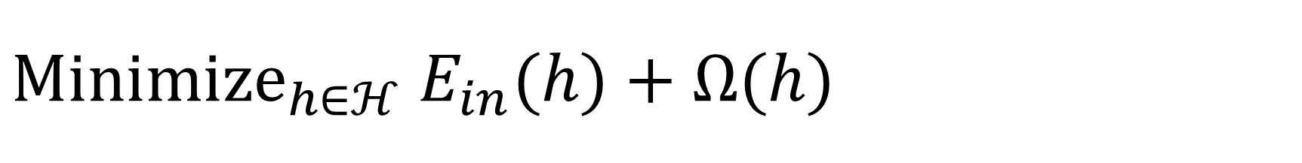
${Minimize}_{h∈ℋ}$ $E_{in}(h)+Ω(h)$
Constrain the search for $h$ with best fit to data (lowest $E_{in}$)
By adding a penalty for the complexity of the hypothesis ($Ω(h)$)
$Ω(h)$: a measure of the complexity of $h$
‘Weight decay’ works well for the linear model
E.g. Sum of squared weights

Slide 5
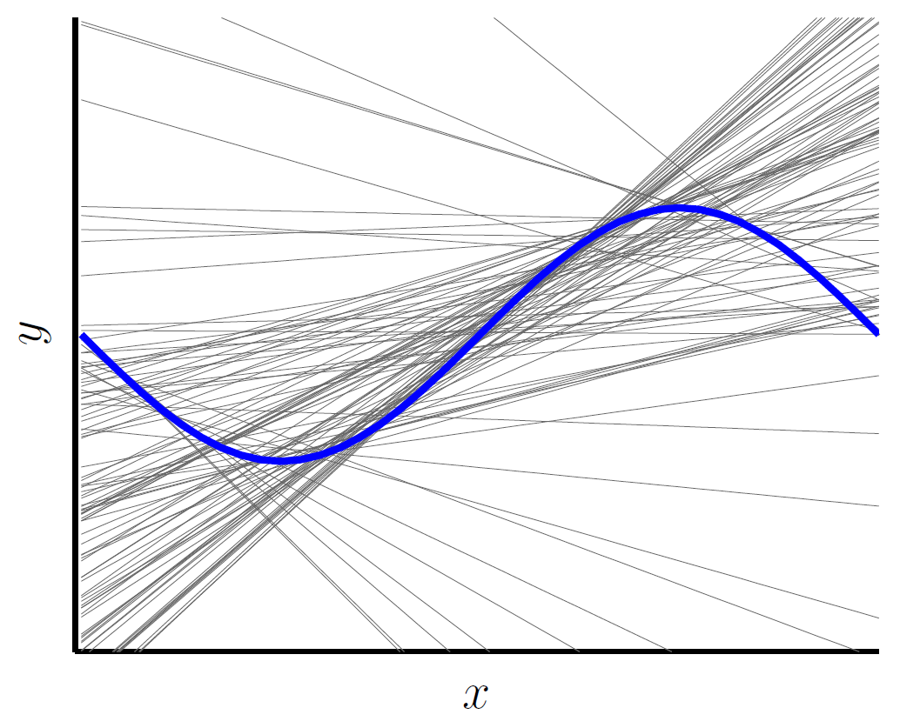
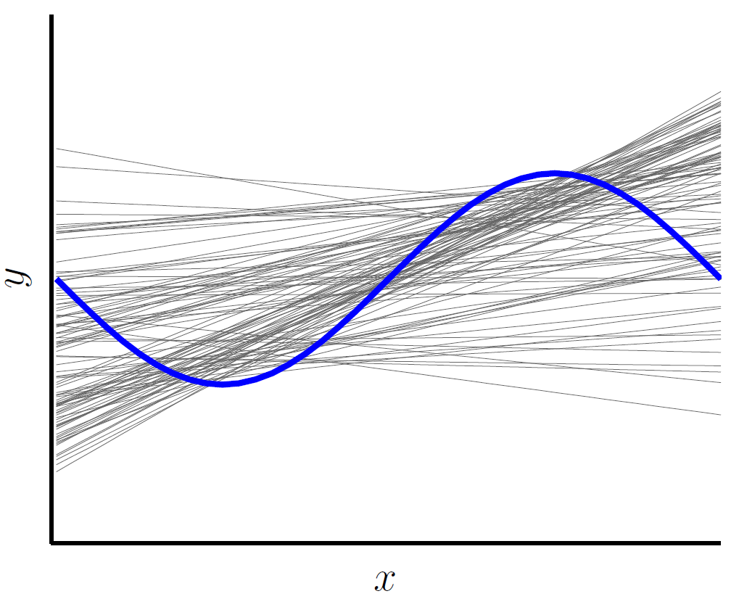
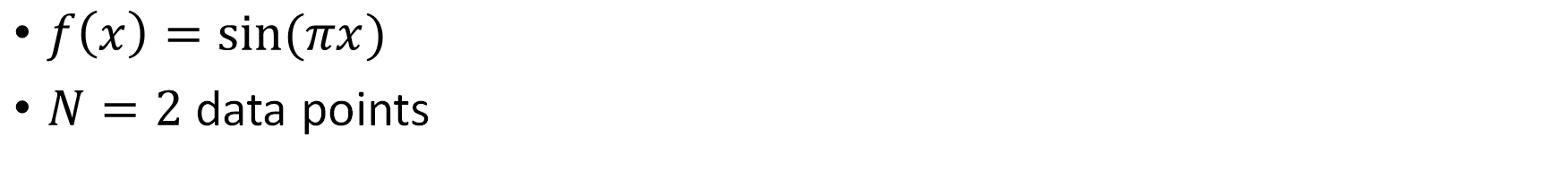
Constraining the Model: Prefer small weights
With regularization
$f\left(x\right)=\sin{(πx)}$
$N=2$ data points

Slide 6
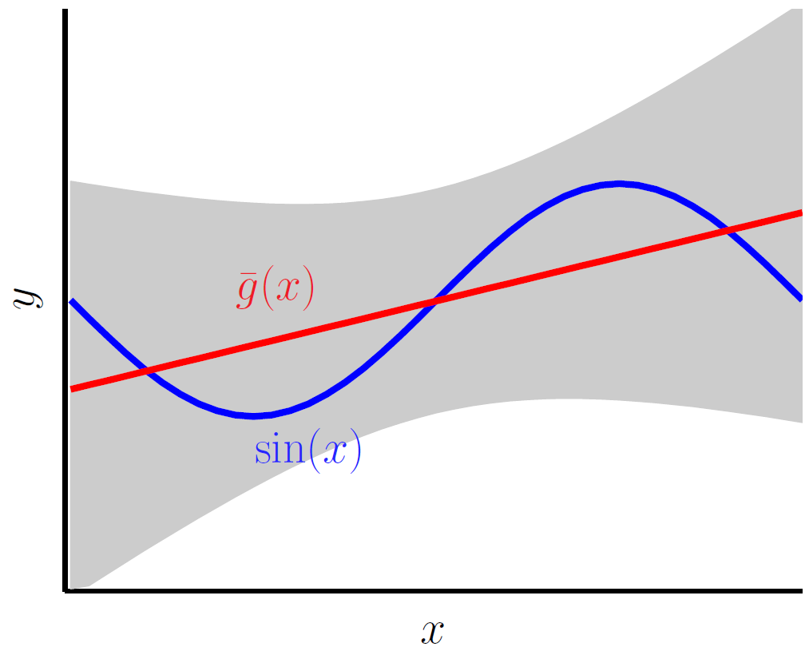
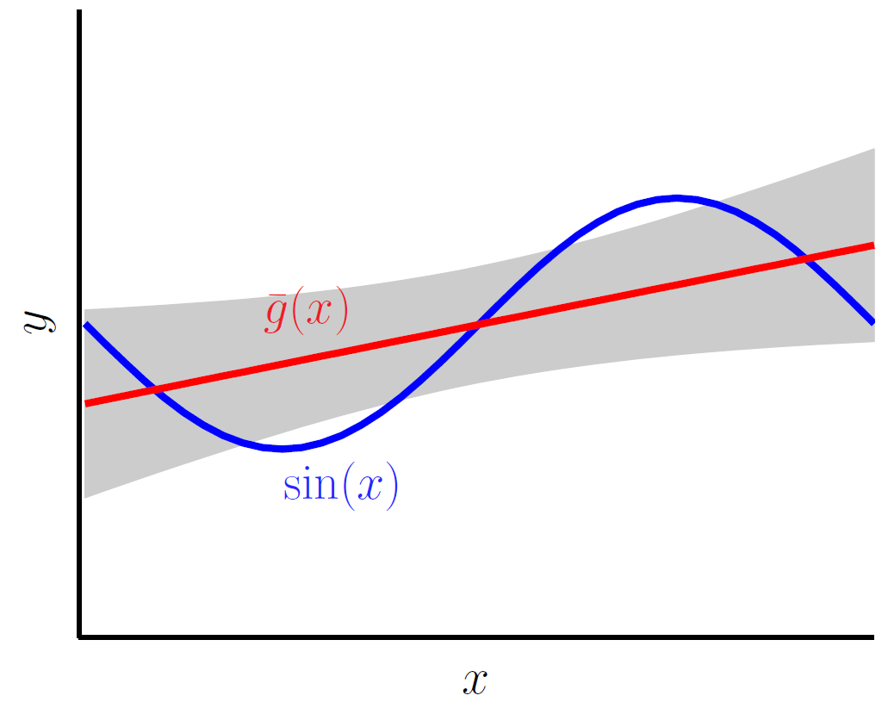
The bias-variance decomposition Side effect of regularization: Bias increases
Without regularization
With regularization
Bias: 0.21
Variance: 1.69
Bias: 0.23
Variance: 0.33

Slide 7

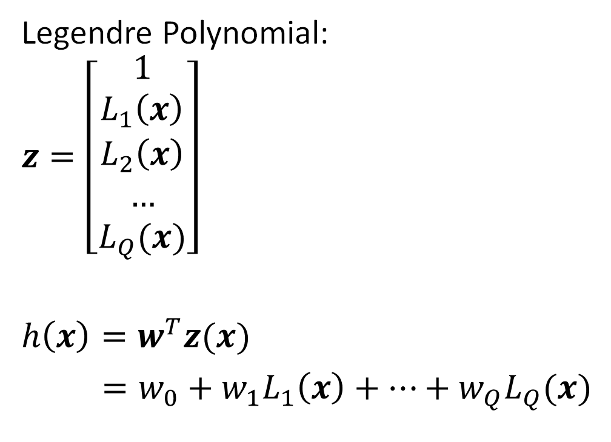
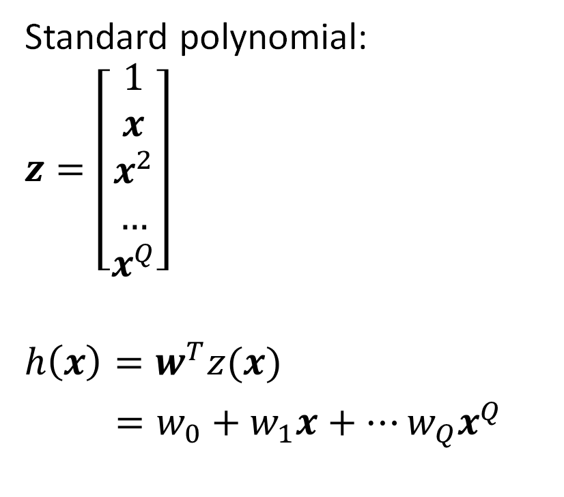
Polynomials of Order $Q$: $ℋ_{Q}$
Standard polynomial:
$z=\left[\begin{aligned}1 \\ x \\ x^{2} \\ … \\ x^{Q}\end{aligned}\right]$
$h\left(x\right)=w^{T}z(x)$
$=w_{0}+w_{1}x+…w_{Q}x^{Q}$
Legendre Polynomial:
$z=\left[\begin{aligned}1 \\ L_{1}\left(x\right) \\ L_{2}\left(x\right) \\ … \\ L_{Q}(x)\end{aligned}\right]$
$h\left(x\right)=w^{T}z(x)$
$=w_{0}+w_{1}L_{1}\left(x\right)+…+w_{Q}L_{Q}(x)$

Slide 8
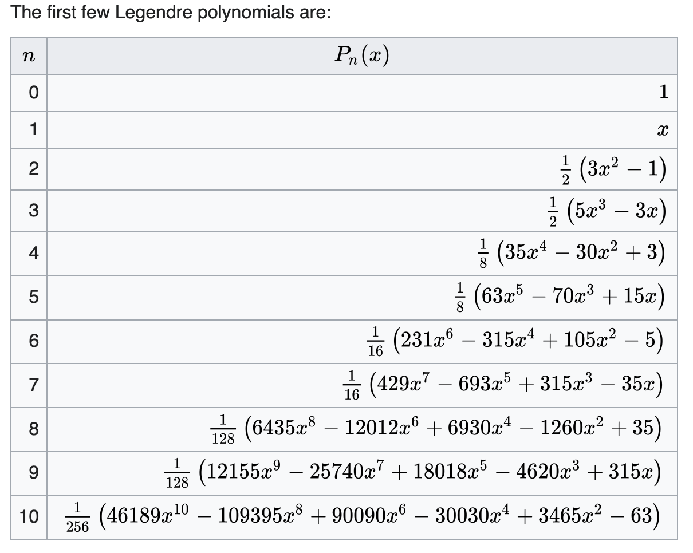
Legendre Polynomial

Slide 9
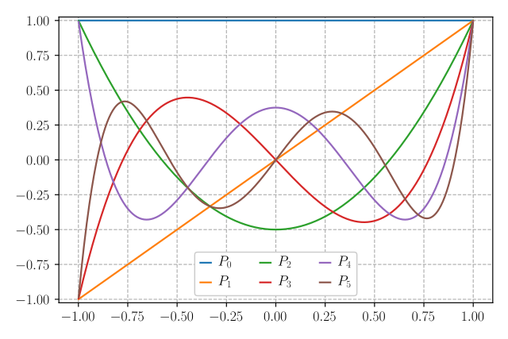
Legendre Polynomial

Slide 10
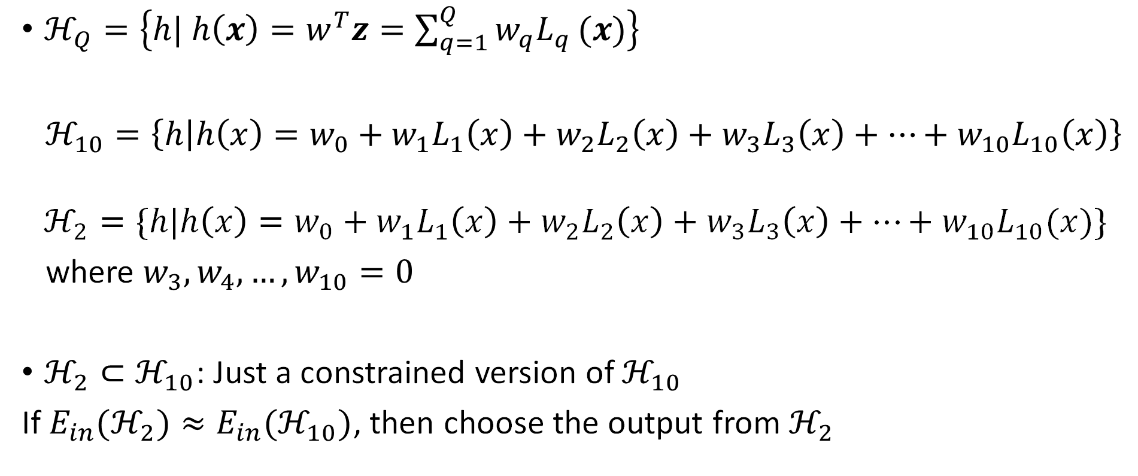
Polynomial Transforms
$ℋ_{Q}=\left\{h| h\left(x\right)=w^{T}z=\sum_{q=1}^{Q}{w_{q}L_{q}}(x)\right\}$
$ℋ_{10}=\left\{h | h\left(x\right)=w_{0}+w_{1}L_{1}\left(x\right)+w_{2}L_{2}\left(x\right)+w_{3}L_{3}\left(x\right)+…+w_{10}L_{10}\left(x\right)\right\}$
$$ℋ_{2}=\{h|h\left(x\right)=w_{0}+w_{1}L_{1}\left(x\right)+w_{2}L_{2}\left(x\right)+w_{3}L_{3}\left(x\right)+…+w_{10}L_{10}(x)\}$$
where $w_{3},w_{4},…,w_{10}=0$
$ℋ_{2}⊂ℋ_{10}$: Just a constrained version of $ℋ_{10}$
If $E_{in}(ℋ_{2})≈E_{in}(ℋ_{10})$, then choose the output from $ℋ_{2}$

Slide 11
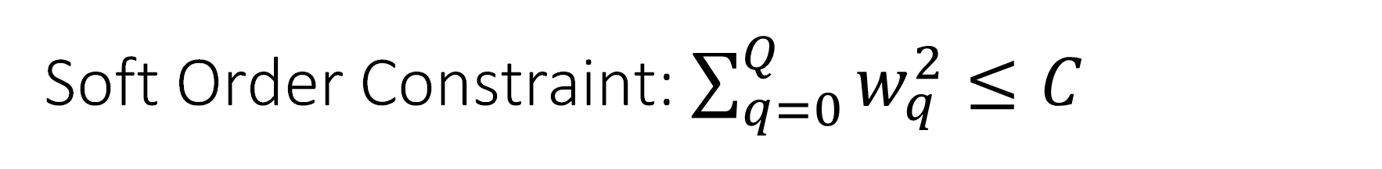
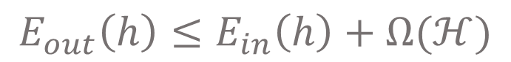
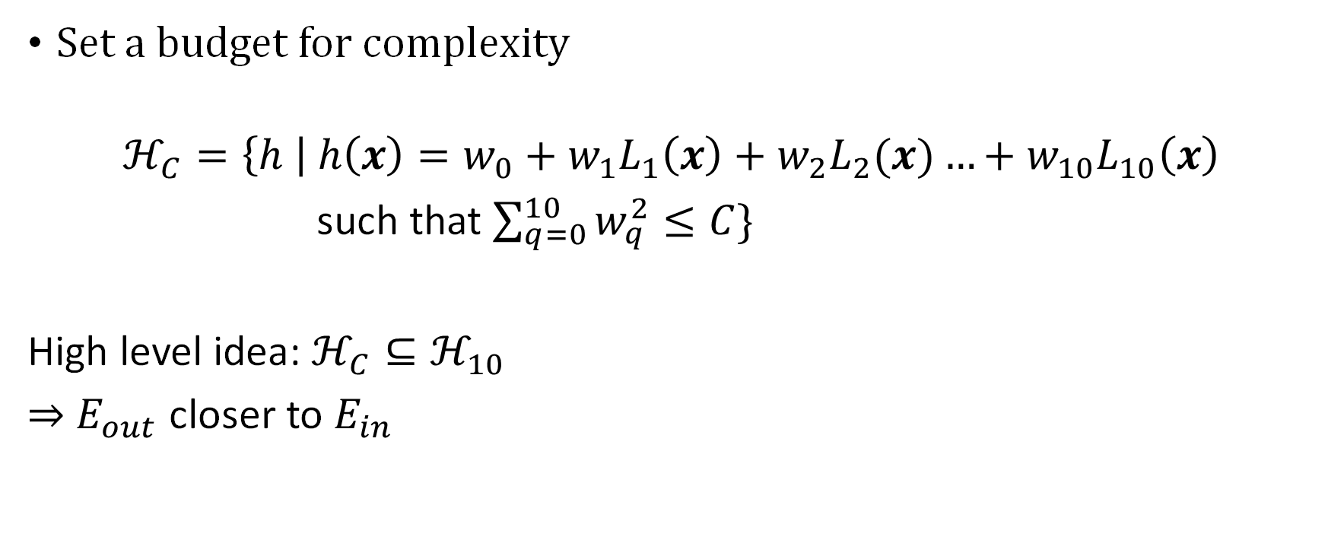
Soft Order Constraint: $\sum_{q=0}^{Q}{w_{q}^{2}}≤C$
Set a budget for complexity
$$ℋ_{C}=\left\{h \right| h\left(x\right)=w_{0}+w_{1}L_{1}\left(x\right)+w_{2}L_{2}(x)…+w_{10}L_{10}\left(x\right)$$
such that $\sum_{q=0}^{10}{w_{q}^{2}}≤C\}$
High level idea: $ℋ_{C}⊆ℋ_{10}$
$⇒$ $E_{out}$ closer to $E_{in}$
$$E_{out}\left(h\right)≤E_{in}\left(h\right)+Ω(ℋ)$$

Slide 12
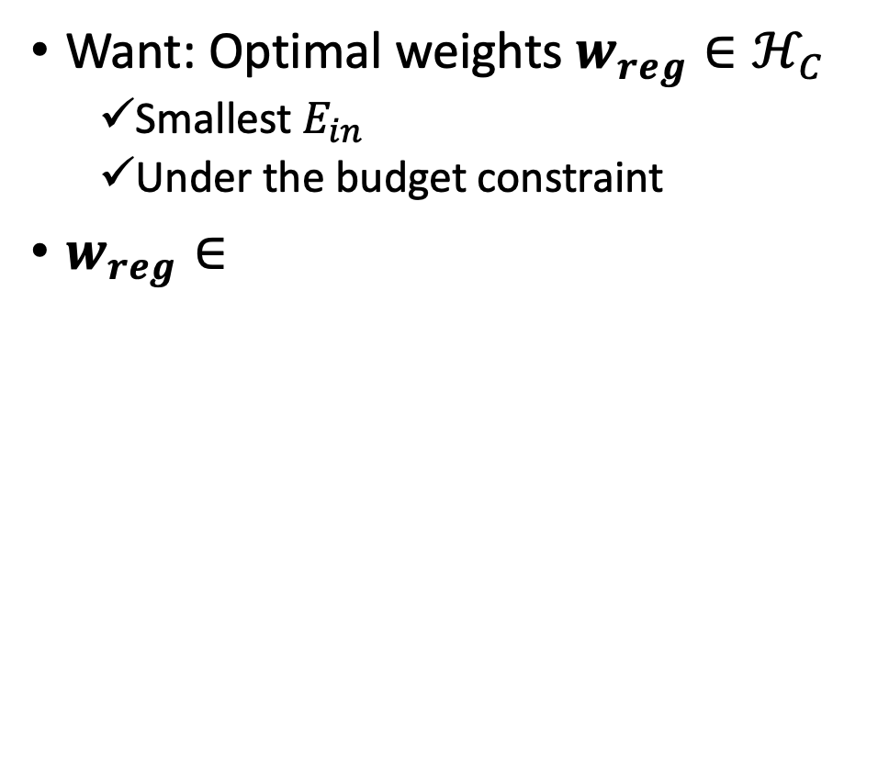
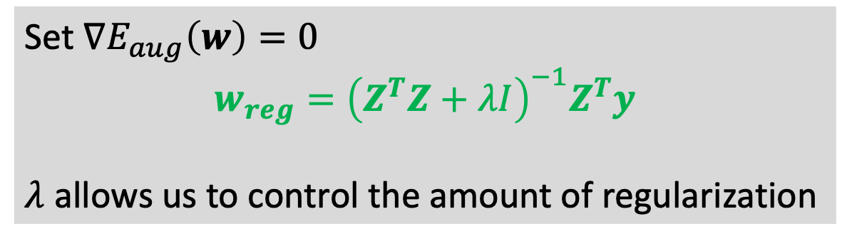

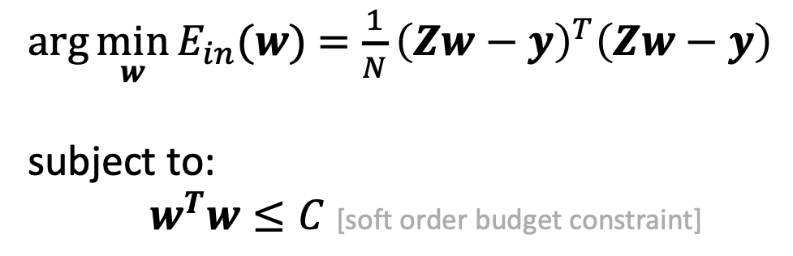
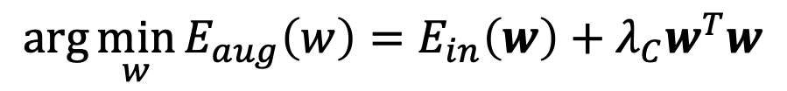
Fitting Optimal Weights Under Budget Constraints
Want: Optimal weights $w_{reg}∈ℋ_{C}$
Smallest $E_{in}$
Under the budget constraint
$w_{reg}∈$
$\arg{\min_{w}{E_{in}(w)}}$ $=\frac{1}{N}{\left(Zw−y\right)}^{T}\left(Zw−y\right)$
subject to:
$w^{T}w≤C$ [soft order budget constraint]
$$≡$$
$$\arg{\min_{w}{E_{aug}\left(w\right)=E_{in}\left(w\right)+λ_{C}w^{T}w}}$$
Set $∇E_{aug}\left(w\right)=0$
$$w_{reg}={\left(Z^{T}Z+λI\right)}^{−1}Z^{T}y$$
$λ$ allows us to control the amount of regularization

Slide 13
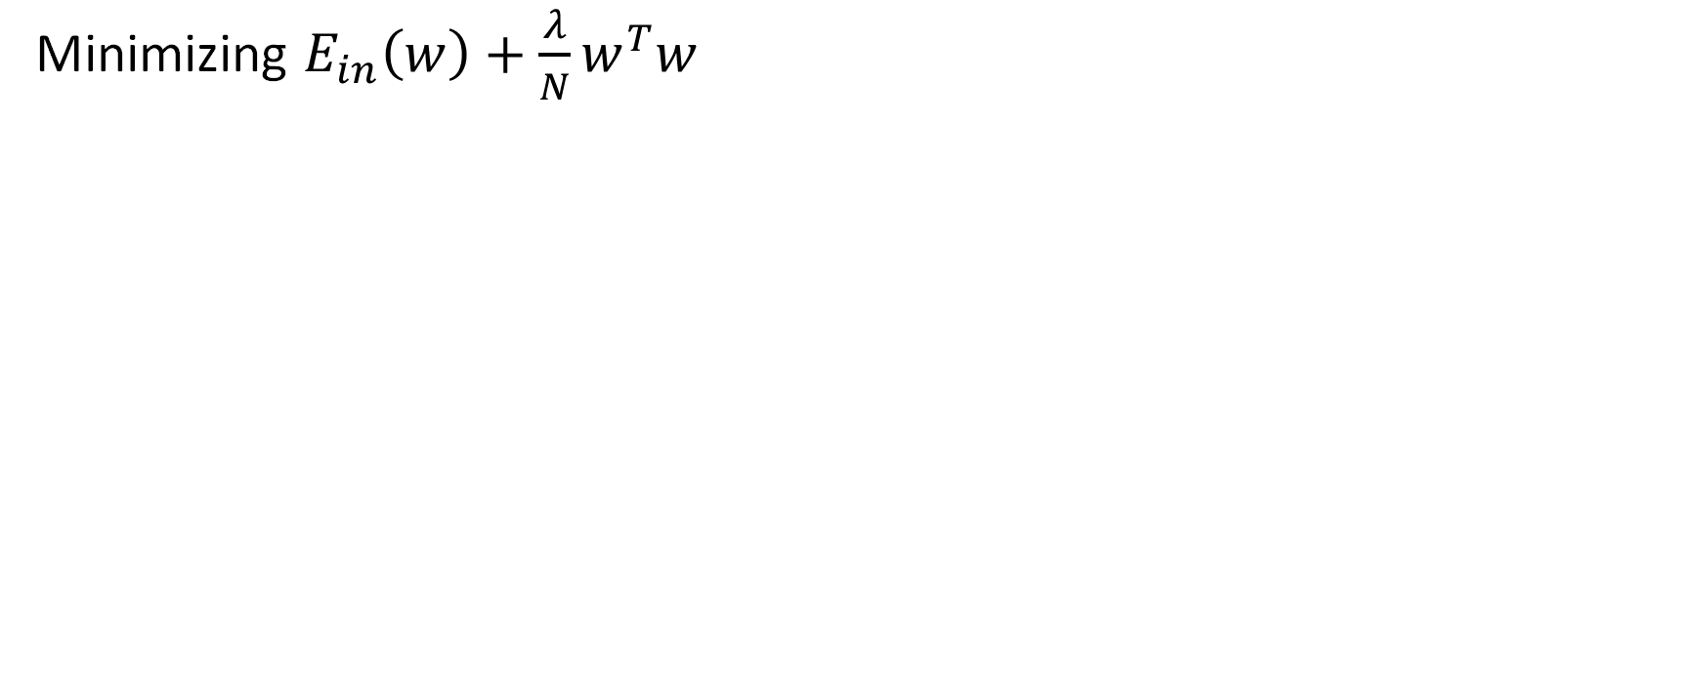
Dose Regularization Approporiately
Minimizing $E_{in}\left(w\right)+\frac{λ}{N}w^{T}w$
Overfitting
Underfitting

Slide 14
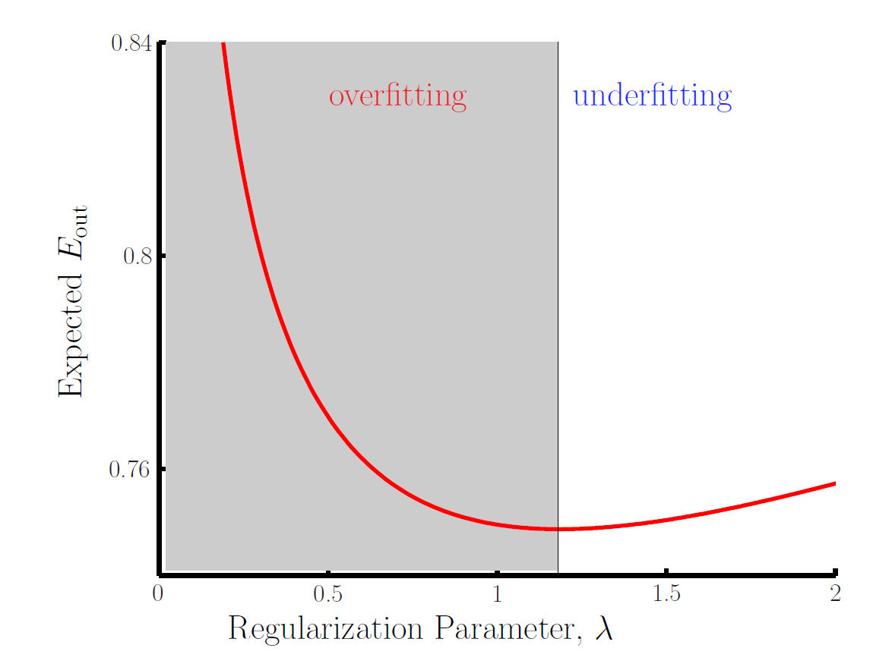
Overfitting and Underfitting

Slide 15
More Noise Demands More Regularization
Stochastic noise
Deterministic noise

Slide 16
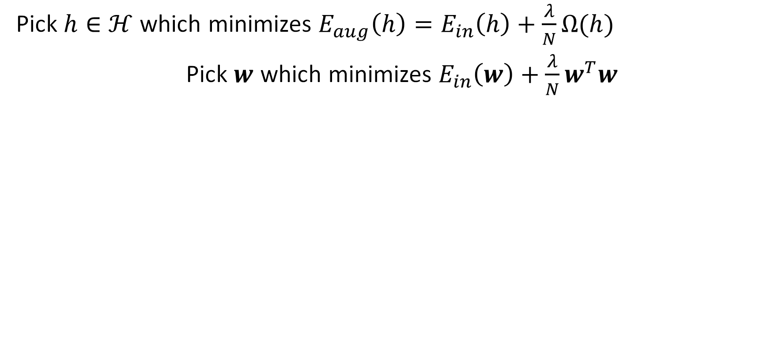
Dose Regularization Appropriately
Pick $h∈ℋ$ which minimizes $E_{aug}\left(h\right)=E_{in}\left(h\right)+\frac{λ}{N}Ω(h)$
Pick $w$ which minimizes $E_{in}\left(w\right)+\frac{λ}{N}w^{T}w$
Overfitting
Underfitting

Slide 17
Overfitting and Underfitting

Slide 18
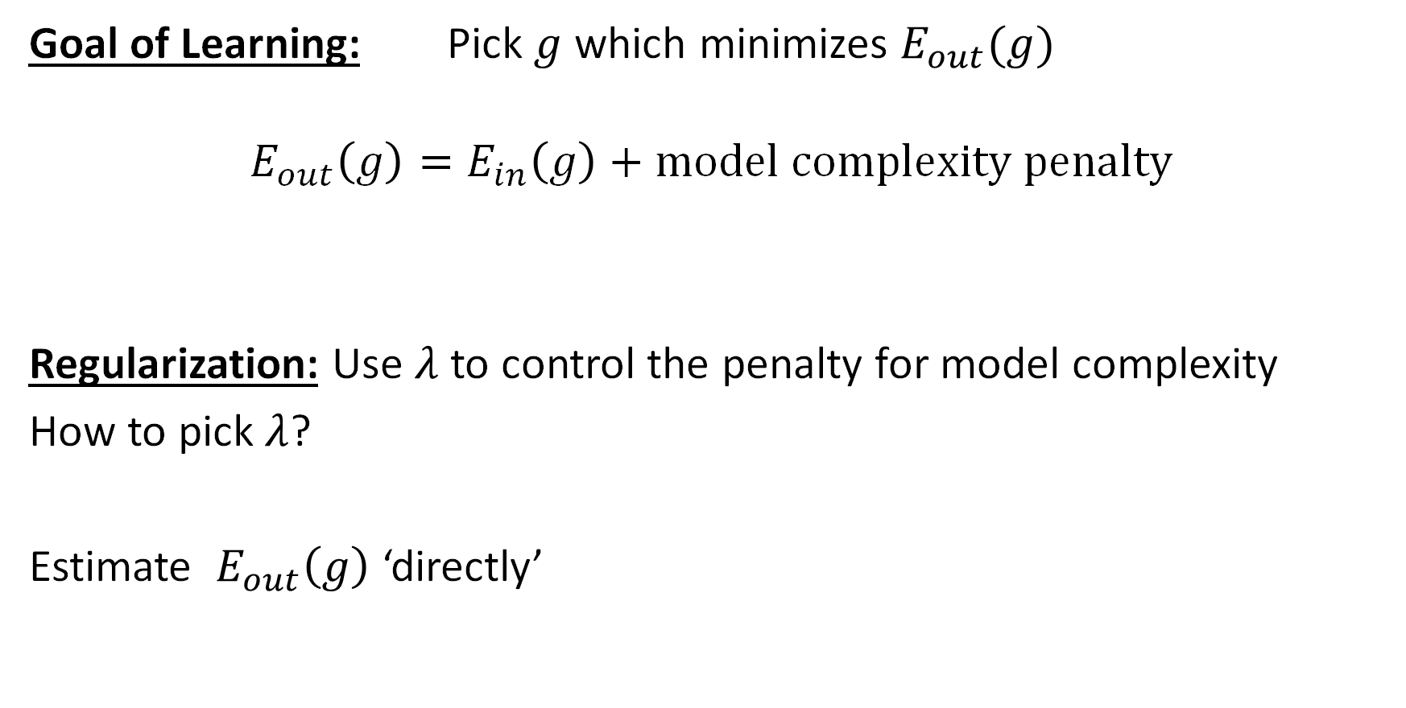
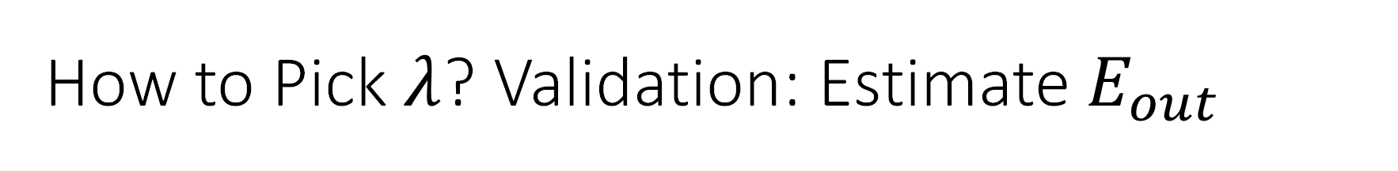
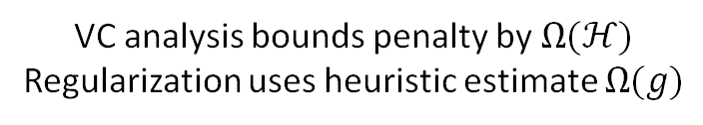
How to Pick $λ$? Validation: Estimate $E_{out}$
Goal of Learning: Pick $g$ which minimizes $E_{out}(g)$
$$E_{out}\left(g\right)=E_{in}\left(g\right)+model complexity penalty$$
Regularization: Use $λ$ to control the penalty for model complexity
How to pick $λ$?
Estimate $E_{out}\left(g\right)$ ‘directly’
VC analysis bounds penalty by $Ω(ℋ)$
Regularization uses heuristic estimate $Ω(g)$

Slide 19

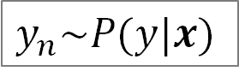



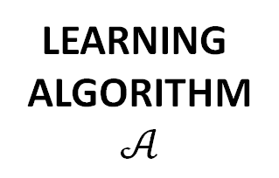
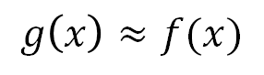
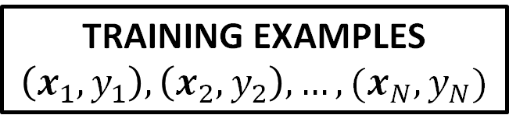
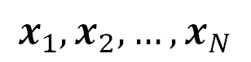
Learning Problem with Error Measure, Noisy Target
UNKNOWN TARGET DISTRIBUTION
$$P(y|x)$$
UNKNOWN INPUT DISTRIBUTION
$$P(x)$$
$$y_{n}\sim P(y|x)$$
TRAINING EXAMPLES
$$\left(x_{1},y_{1}\right), \left(x_{2},y_{2}\right), …,(x_{N},y_{N})$$
$$x_{1},x_{2},…,x_{N}$$
ERROR
MEASURE
$$g\left(x\right)≈f(x)$$
LEARNING
ALGORITHM
$$𝒜$$
FINAL HYPOTHESIS
$$g$$
HYPOTHESIS SET
$$ℋ$$

Slide 20
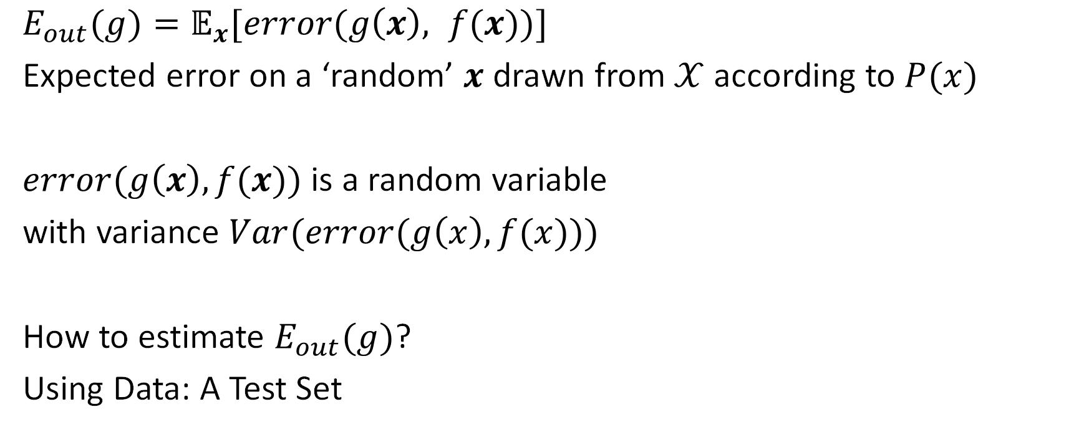
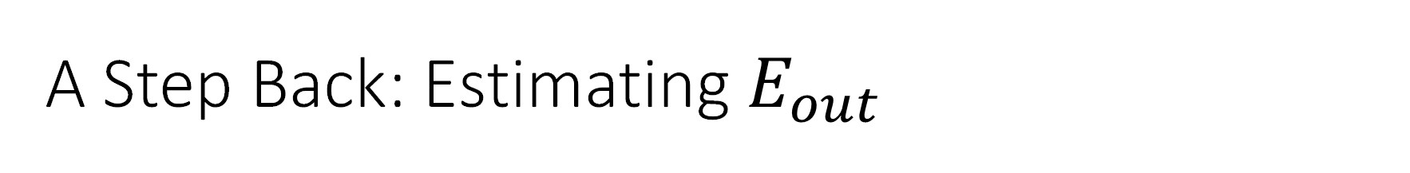
A Step Back: Estimating $E_{out}$
$E_{out}(g)=𝔼_{x}[error(g\left(x\right), f(x))]$
Expected error on a ‘random’ $x$ drawn from $𝒳$ according to $P(x)$
$error(g\left(x\right), f(x))$ is a random variable
with variance $Var(error(g\left(x\right), f(x)))$
How to estimate $E_{out}(g)$?
Using Data: A Test Set

Slide 21

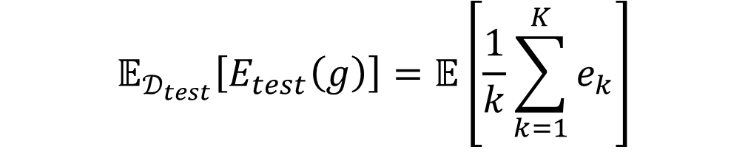
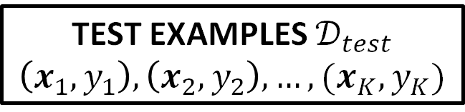
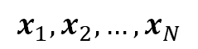
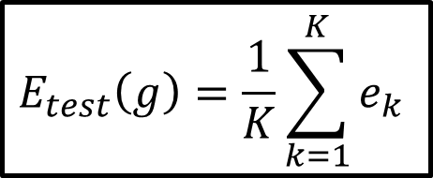
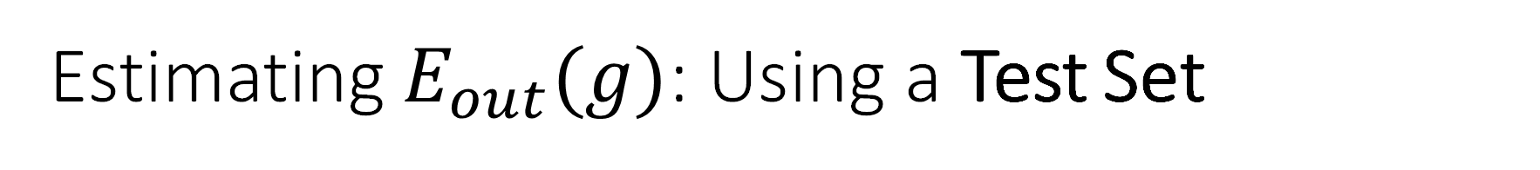
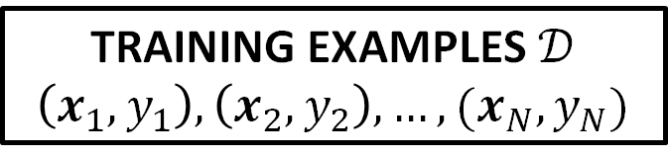
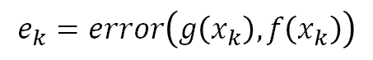
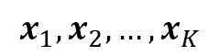
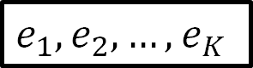
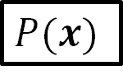
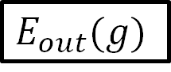
Estimating $E_{out}(g)$: Using a Test Set
$$P(x)$$
$$x_{1},x_{2},…,x_{N}$$
$$x_{1},x_{2},…,x_{K}$$
TRAINING EXAMPLES $𝒟$
$$\left(x_{1},y_{1}\right), \left(x_{2},y_{2}\right), …,(x_{N},y_{N})$$
TEST EXAMPLES $𝒟_{test}$
$$\left(x_{1},y_{1}\right), \left(x_{2},y_{2}\right), …,(x_{K},y_{K})$$
FINAL HYPOTHESIS
$$g$$
$$e_{k}=error\left(g\left(x_{k}\right),f\left(x_{k}\right)\right)$$
$$e_{1},e_{2},…,e_{K}$$
$$E_{test}\left(g\right)=\frac{1}{K}\sum_{k=1}^{K}{e_{k}}$$
$$E_{out}(g)$$
$$𝔼_{𝒟_{test}}\left[E_{test}\left(g\right)\right]=𝔼\left[\frac{1}{k}\sum_{k=1}^{K}{e_{k}}\right]$$

Slide 22
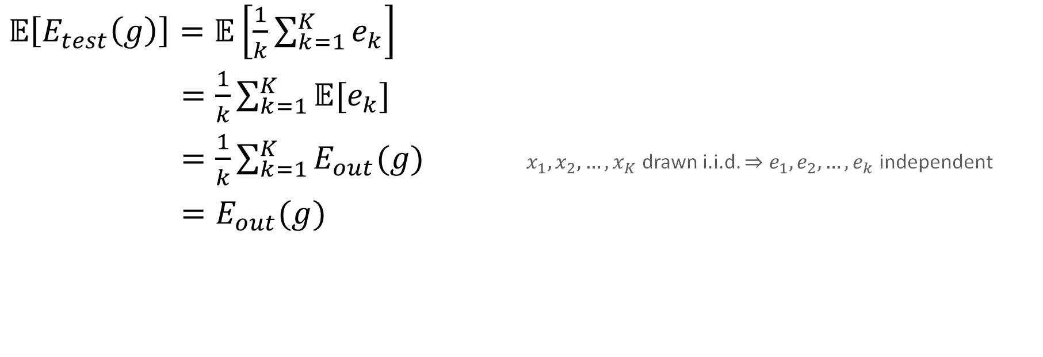
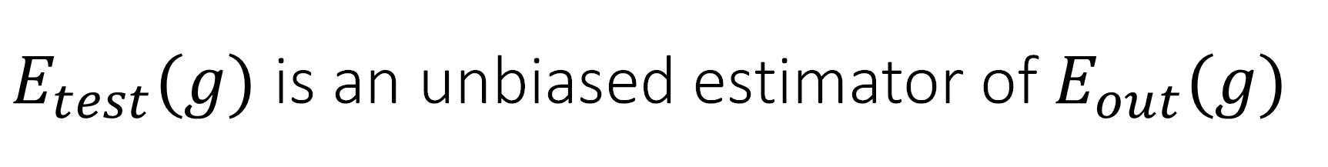
$E_{test}(g)$ is an unbiased estimator of $E_{out}(g)$
$𝔼\left[E_{test}\left(g\right)\right]=𝔼\left[\frac{1}{k}\sum_{k=1}^{K}{e_{k}}\right]$
$=\frac{1}{k}\sum_{k=1}^{K}{𝔼[e_{k}]}$
$=\frac{1}{k}\sum_{k=1}^{K}{E_{out}(g)}$ $x_{1},x_{2},…,x_{K}$ drawn i.i.d. $⇒e_{1},e_{2},…,e_{k}$ independent
$=E_{out}(g)$

Slide 23


Variance of $E_{test}(g)$
$Var\left[E_{test}\left(g\right)\right]=Var\left[\frac{1}{K}\sum_{k=1}^{K}{e_{k}}\right]$
$=\frac{1}{K^{2}}Var\left[\sum_{k=1}^{K}{e_{k}}\right]$ $Var\left(aX\right)=a^{2}Var\left(X\right)$ for any random variable $X$
$=\frac{1}{K^{2}}\sum_{k=1}^{K}{Var[e_{k}]}$ $e_{1},e_{2},…,e_{k}$ independent
$=\frac{1}{K^{2}}\sum_{k=1}^{K}{Var[error(g(x),f(x))]}$
$=\frac{1}{K}Var[error(g(x),f(x))]$

Slide 24


Estimating $E_{out}(g)$ using a Test Set
$𝔼\left[E_{test}\left(g\right)\right]=E_{out}(g)$
$Var\left[E_{test}\left(g\right)\right]=\frac{1}{K}Var[error(g(x),f(x))]$
Relationship between $E_{test}\left(g\right)$ and $E_{out}(g)$ for a single hypothesis
Using Hoeffding’s inequality: $E_{out}\left(g\right)≤E_{test}\left(g\right)+O\left(\frac{1}{\sqrt{K}}\right)$
$E_{out}\left(g\right)≈E_{test}\left(g\right)±\frac{1}{\sqrt{K}}\sqrt{Var[error(g(x),f(x))]}$
Larger $K$ (size of $𝒟_{test}$) $→$ $E_{test}(g)$ better estimate for $E_{out}(g)$

Slide 25


The Validation Set $𝒟_{val}$: Because $𝒟_{test}$ is unknown
$𝒟_{test}$ is held by the customer. Not available during learning
How to estimate $E_{out}$? How to pick $λ$?
Hold-out a subset of training examples
Partition input dataset $𝒟=\{\left(x_{1},y_{1}\right), \left(x_{2},y_{2}\right), …,\left(x_{N},y_{N}\right)\}$
into two data sets:
$𝒟_{val}$ with $K$ examples chosen from $𝒟$ i.i.d. uniformly at random
$𝒟_{train}$ with $N−K$ remaining examples

Slide 26












Estimating $E_{out}(g)$: Using a Validation Set
$$P(x)$$
$$x_{1},x_{2},…,x_{N}$$
$$𝒟$$
$$𝒟_{train}$$
($N−K$ training points)
$$𝒟_{val}$$
($K$ validation points)
Partition $𝒟={𝒟_{val}∪𝒟}_{train}$
Learn using $𝒟_{train}$ $→$ $g^{−}$
Pick $g^{−}$ from $ℋ$ using $𝒜$
Evaluate $g^{−}$ on $𝒟_{val}$ $→$ $E_{val}(g)$
$𝔼\left[E_{val}\left(g^{−}\right)\right]=E_{out}(g^{−})$
$Var\left[E_{val}\left(g^{−}\right)\right]=\frac{1}{K}Var[error(g^{−},f)]$
LEARN
$$g^{−}$$
$$e_{k}=error\left(g\left(x_{k}\right),f\left(x_{k}\right)\right)$$
$$e_{1},e_{2},…,e_{K}$$
$$E_{val}\left(g\right)=\frac{1}{K}\sum_{k=1}^{K}{e_{k}}$$
$$E_{out}(g^{−})$$

Slide 27

But There is a Price to Pay
$E_{out}\left(g\right)=E_{val}\left(g\right)+O\left(\frac{1}{\sqrt{K}}\right)$
Larger $K$ $⇒$ Better estimate of $E_{out}$
Larger $K$ $⇒$ Fewer data points for training
$⇒$ $E_{out}$ increases
$⇒$ $E_{val}$ increases
$⇒$ $σ_{val}$ increases, the uncertainty in $E_{val}$

Slide 28






An Example $Q_{f}=10, N=40, σ_{noise}=0.4$
$Var[E_{val}]$ $↓$
$Var[e_{k}(g^{−})]$ $↑$
$$𝔼[E_{val}]≈E_{out}(g^{−}(K))$$
$$± σ_{val}$$
Rule of Thumb: $K^{∗}=\frac{N}{5}$

Slide 29












Restoring $𝒟$
$$𝒟$$
$$\left(N\right)$$
Primary Goal for Learning:
Output $g$ with smallest $E_{out}$
Secondary Goal:
Estimate $E_{out}$
$$𝒟_{train}$$
$$\left(N−K\right)$$
$$𝒟_{val}$$
$$\left(K\right)$$
$$g^{−}$$
$$E_{out}(g)$$
$$E_{out}(g^{−})$$
Deficient!
Output
$$E_{in}(g)$$
$$E_{val}(g^{−})$$
$$g$$
$$E_{val}(g^{−})$$

Slide 30


Using $E_{val}(g^{−})$ to Estimate $E_{out}(g)$
From VC analysis:
$$E_{out}\left(g\right)≤E_{in}\left(g\right)+O\left(\sqrt{\frac{d_{VC}}{N}\log{N}}\right)$$
From Validation:
$$E_{out}\left(g\right)≤E_{out}\left(g^{−}\right)≤E_{val}\left(g^{−}\right)+O\left(\frac{1}{\sqrt{K}}\right)$$
Typically $E_{val}(g)$ is a better estimate of $E_{out}(g)$ than $E_{in}(g)$

Slide 31




Using $E_{val}(g^{−})$ to Estimate $E_{out}(g)$
From VC analysis:
$$E_{out}\left(g\right)≤E_{in}\left(g\right)+O\left(\sqrt{\frac{d_{VC}}{N}\log{N}}\right)$$
From Hoeffding Inequality:
$$E_{out}\left(g^{−}\right)≤E_{val}\left(g^{−}\right)+O\left(\frac{1}{\sqrt{K}}\right)$$
Typically, $E_{val}(g^{−})$ is a better estimate of $E_{out}(g)$ than $E_{in}(g)$
$d_{VC}$ may be large
Typically, $E_{out}\left(g\right)≤$
Small $K$
Large $K$

Slide 32



















Use Validation to Evaluate Models
$$ℋ_{1}$$
$$ℋ_{2}$$
$$ℋ_{3}$$
$$⋯$$
$$ℋ_{M}$$
$$𝒟_{train}$$
$$g_{1}^{−}$$
$$g_{2}^{−}$$
$$g_{3}^{−}$$
$$⋯$$
$$g_{M}^{−}$$
$$𝒟_{val}$$
$$⋯$$
$$E_{1}$$
$$E_{2}$$
$$E_{3}$$
$$E_{M}$$
$$E_{m}≈E_{out}(g_{m}^{−})$$
Estimate $E_{out}(g_{m}^{−})$ using validation data set $𝒟_{val}$

Slide 33



Pick Model with Best Validation Error
$$ℋ_{1}$$
$$ℋ_{2}$$
$$ℋ_{3}$$
$$⋯$$
$$ℋ_{M}$$
$$𝒟_{train}$$
$$g_{1}^{−}$$
$$g_{2}^{−}$$
$$g_{3}^{−}$$
$$⋯$$
$$g_{M}^{−}$$
$$𝒟_{val}$$
$$⋯$$
$$E_{1}$$
$$E_{2}$$
$$E_{3}$$
$$E_{M}$$
Use $E_{val}(g_{m}^{−})$ to evaluate $ℋ_{m}$
Pick a model $ℋ_{∗}$ with lowest $E_{val}(g_{∗}^{−})$
Pick $g_{∗}^{−}$ from among $g_{1}^{−},g_{2}^{−},g_{3}^{−},…,g_{M}^{−}$

Slide 34
Restoring $𝒟$
$$𝒟$$
$$\left(N\right)$$
Primary Goal for Learning:
Output $g$ with smallest $E_{out}$
Secondary Goal:
Estimate $E_{out}$
$$𝒟_{train}$$
$$\left(N−K\right)$$
$$𝒟_{val}$$
$$\left(K\right)$$
$$g^{−}$$
$$E_{out}(g)$$
$$E_{out}(g^{−})$$
Deficient!
Output
$$E_{in}(g)$$
$$E_{val}(g^{−})$$
$$g$$
$$E_{val}(g^{−})$$

Slide 35













Cross Validation [or $K=1$]
$$e_{3}$$
$$y$$
$$y$$
$$e_{2}$$
$$y$$
$$e_{1}$$
$$x$$
$$x$$
$$x$$
${𝔼[e}_{k}]=E_{out}(g_{k}^{−})$, High Variance
But $g_{1}^{−},g_{2}^{−},g_{3}^{−},…$ are all close to $g$ trained on all data points
Take the average:
$$E_{CV}=\frac{1}{N}\sum_{n=1}^{N}{e_{n}}$$
leave one out error
for leaving out $(x_{n},y_{n})$
Cross Validation Error

Slide 36


Cross Validation Estimate of $E_{out}$
Theorem:
$𝔼_{𝒟_{N}}\left[E_{CV}\right]=E_{out}\left(N−1\right)$,
the expected error when we learn with $N−1$ datapoints
$E_{out}\left(g\right)≤E_{CV}+O\left(\frac{1}{\sqrt{N}}\right)$? Not exactly. $e_{1},e_{2},…,e_{N}$ are not independent

Slide 37























Cross Validation: Restoring $𝒟$
For each
$$ℋ_{1}$$
$$ℋ_{2}$$
$$ℋ_{3}$$
$$⋯$$
$$ℋ_{M}$$
Measure $E_{CV}$
$$𝒟_{1}$$
$$𝒟_{2}$$
$$⋯$$
$$𝒟_{N}$$
$$𝒟$$
$$g_{1}^{−}$$
$$g_{2}^{−}$$
$$g_{N}^{−}$$
$$(x_{1},y_{1})$$
$$(x_{2},y_{2})$$
$$(x_{N},y_{N})$$
$$e_{1}$$
$$e_{2}$$
$$e_{N}$$
average
$$g$$
$$E_{CV}$$

Slide 38


(Cross-)Validation for Model Selection
Or Even Feature Selection
An Example:
MNIST Digits Data
2 features: Intensity and Symmetry
Perceptron Learning Algorithm (Pocket)
5th Order Polynomial Transform
How many / Which features to use?
$ℋ_{1}=\left[\begin{aligned}1 \\ z_{1}\end{aligned}\right], ℋ_{2}=\left[\begin{aligned}1 \\ z_{1} \\ z_{2}\end{aligned}\right],…, ℋ_{20}=\left[\begin{aligned}1 \\ z_{1} \\ ⋮ \\ z_{20}\end{aligned}\right]$
$$\left[\begin{aligned}1 \\ x_{1} \\ x_{2}\end{aligned}\right]→\left[\begin{aligned}1 \\ x_{1} \\ x_{2} \\ x_{1}^{2} \\ x_{1}x_{2} \\ x_{2}^{2} \\ x_{1}^{3} \\ ⋮ \\ x_{2}^{3} \\ x_{1}^{4} \\ ⋮ \\ x_{2}^{4} \\ x_{1}^{5} \\ ⋮ \\ x_{2}^{5}\end{aligned}\right]=\left[\begin{aligned}1 \\ z_{1} \\ ⋮ \\ z_{20}\end{aligned}\right]$$

Slide 39
Cross-Validation for Model Selection
1s vs. Not 1s

Slide 40





Minimizing $E_{in}$ vs Minimizing $E_{CV}$
$ℋ_{20}$ has lowest $E_{in}$
$ℋ_{6}$ has lowest $E_{CV}$
$$E_{in}=0\%$$
$$E_{out}=2.5\%$$
$$E_{in}=0.8\%$$
$$E_{out}=1.5\%$$

Slide 41
Three Learning Principles
Occam’s Razor: Select a Model Carefully
Sampling Bias: Generate Data Carefully
Data Snooping: Handle Data Carefully

Slide 42


Slide 43
P1: Occam’s Razor (and similar principles)
Occam: “entities should not be multiplied without necessity”
Reinterpreted (heavily):
“an explanation of the data should be made
as simple as possible, but no simpler”
For credibility: Einstein, probably
The simplest model that fits the data is the most plausible

Slide 44


Simpler?
Simplicity of a hypothesis $h$:
$Ω(h)$
Low order polynomial
Hypothesis with small weights
Easily described
$…$
Simplicity of a hypothesis set $ℋ$:
$Ω(ℋ)$
Low $d_{VC}$
Small number of hypotheses
Low entropy set
$…$

Slide 45

Why is a simpler hypothesis better?
It is more surprising (more significant) when you fit the data
Start with a simple $ℋ$ (as opposed to a more complex hypothesis set)
You should expect to fail (often)
If you succeed in fitting the data, it is all the more significant

Slide 46



A Scientific Experiment
Who provides most evidence for the hypothesis that $ρ$ is linear in $T$?

Slide 47
Scientist 2 vs. Scientist 3
very convincing
somewhat convincing?

Slide 48
Scientist 1 vs. Scientist 3
no evidence
some evidence?

Slide 49
Axiom of Non-Falsifiability
It must be possible to Falsify the Hypothesis Through Your Experiment
X
Very Significant

Slide 50


Falsification and $m_{ℋ}(N)$
If $ℋ$ can shatter $𝒟$, i.e.,
if it can implement all possible dichotomies on $x_{1},…,x_{N}$
Then it is not surprising that $ℋ$ can fit the data perfectly
Cannot falsify the claim: ‘$ℋ$ is a good set of hypotheses for $f$’

Slide 51


Falsification and $m_{ℋ}(N)$
If $ℋ$ doesn’t shatter $x_{1},…,x_{N}$
and number of dichotomies $ℋ$ can implement is $m_{ℋ}(N)$
and the target values are uniformly distributed
$$ℙ\left[falsification\right]≥1−\frac{m_{ℋ}\left(N\right)}{2^{N}}$$
When $ℋ$ fits $𝒟$ well, it is significant
Because it was possible to falsify the claim that
‘$ℋ$ is a good set of hypotheses for $f$’
The data must have a chance to ‘win’

Slide 52
Learning Goes Beyond Occam’s Razor
We may opt for ‘a simpler fit than possible’,
namely an imperfect fit of the data using a simple model
over a perfect fit using a more complex one.
The reason is that the price we pay for a perfect fit in terms of the penalty for model complexity may be too much in comparison to the benefit of the better fit.
- LFD

Slide 53

P2: Sampling Bias
Randomly Pick People from the Phonebook
Whom did they Vote For?
1948

Slide 54

Sampling Bias in Learning
Truman
Ensure that the training and test distributions are the same
If the data is sampled in a biased way,
learning will produce a similarly biased outcome.

Slide 55
Examples
Social Media
Carefully curated
The GRE: A test that fails

Slide 56

Data Snooping
If a dataset has affected any step in the learning process,
it cannot be fully trusted in assessing the outcome.
Estimate $E_{out}$ using data that has not affected any aspect of the learning process
Choose $ℋ$ before looking at the data

Slide 57
How ‘85’s S&P 500 Stocks Actually Performed
Why?
Choosing stocks based on the test set (future performance)
The same data is being used to:
Pick stocks
Evaluate their returns

Slide 58

Data Snooping Can Be Subtle. Watch Out!
The data looks linear, so I will use a linear model.
What is the $d_{VC}$ of the hypothesis set from which you chose the linear model?
Try different models until one works?
If you torture the data enough, it will confess.
Linear worked well, so I’m done!
Would you have done things differently if you hadn’t seen the data?
Literature survey of things others have tried. I will improve upon it.
Input normalization: normalize all data together and set aside a portion as test set.
Would the output $g$ change if the test set were to change?

Slide 59
Account for Every Choice Influenced by the Data

Slide 60
Three Learning Principles
Occam’s Razor: Select a Model Carefully
Sampling Bias: Generate Data Carefully
Data Snooping: Handle Data Carefully

